Slide 1
extending communication range
Device’s data rate (“duty cycle”)
Gbytes per day
bytes per day
20 years
hours
inches
Battery life (low-power operation)
body/room
building
factory/ campus
miles
Device-to-gateway range

Slide 2
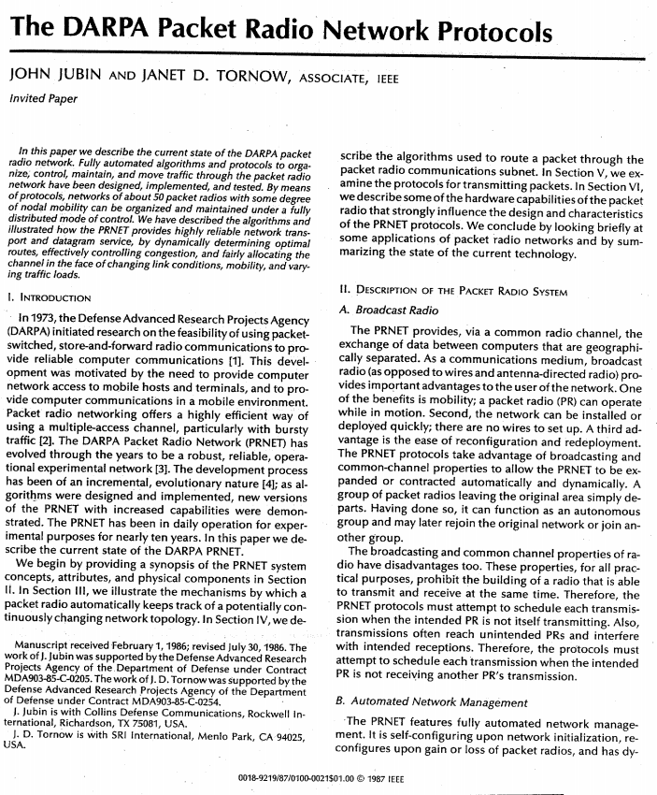
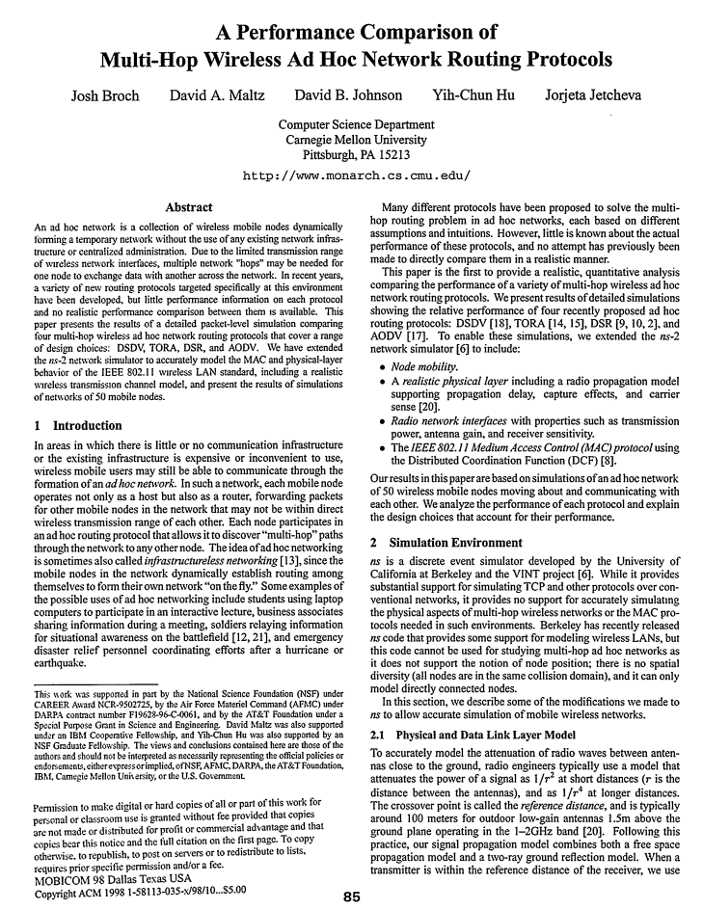
EXTENDING RANGE: MESH NETWORKS
1980s: DARPA packet radio networks
1990s: mobile ad hoc networks (MANET)

Slide 3
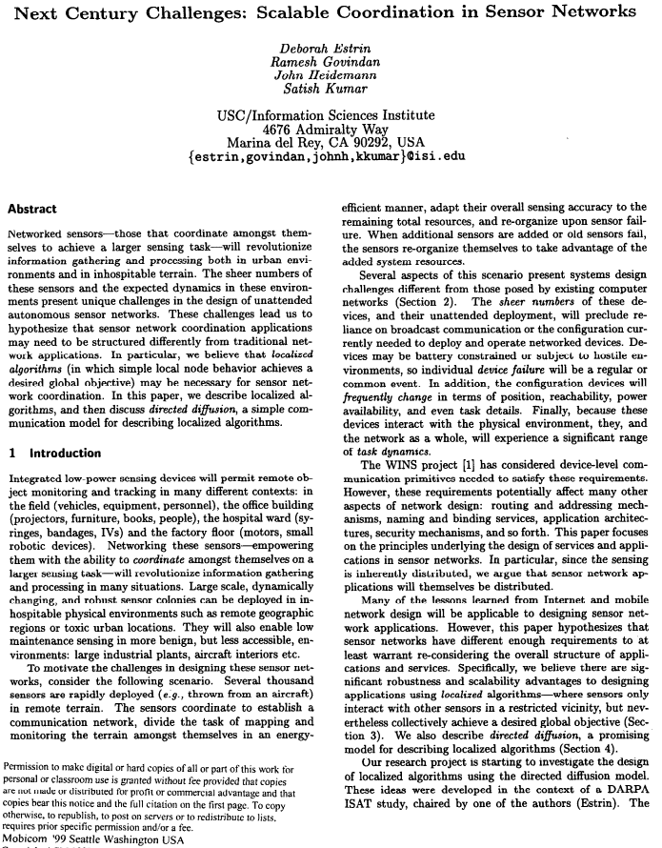
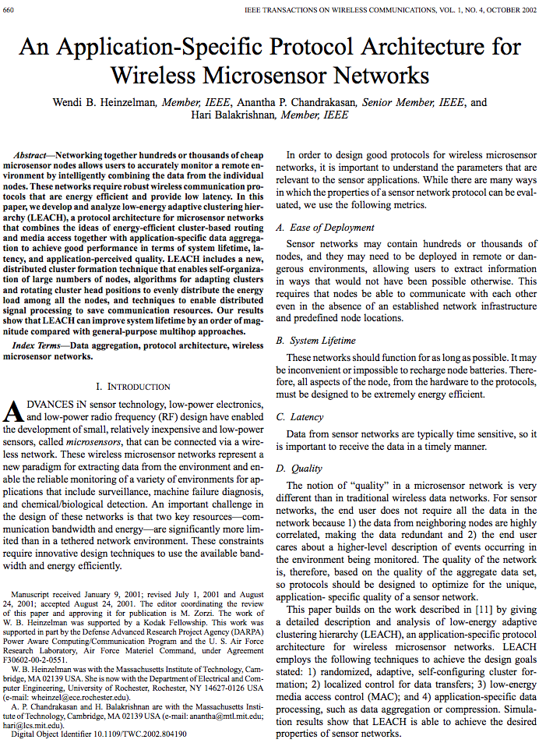
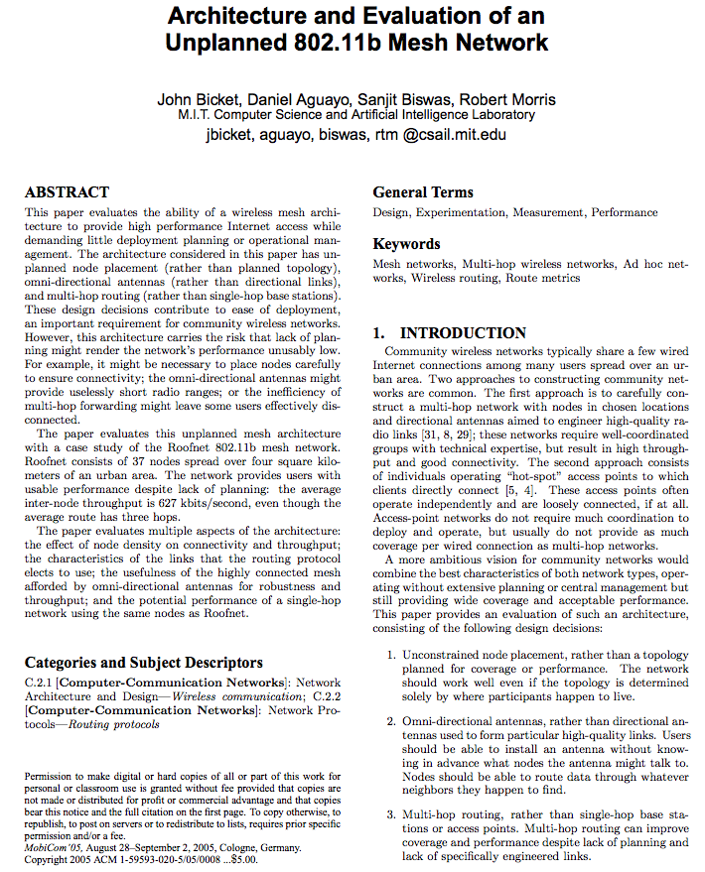
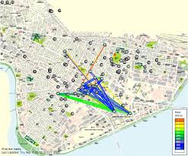
Extending range: mesh networks
Late 90s, 2000s: Sensor networks
2000s: Mesh networks for Internet

Slide 4
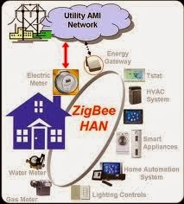
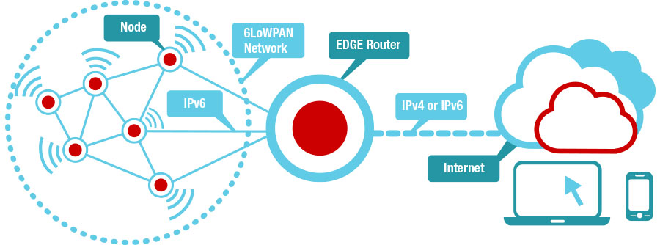
Extending range: mesh networks
2010s: Mesh networks for IoT
6LoWPAN: IPv6 over low-power wireless personal area networks
Zigbee
http://processors.wiki.ti.com/index.php/Contiki-6LOWPAN (Creative commons)
Both (typically) run over the 802.15.4 MAC standard
Routing protocol with different metrics, such as “expected transmission time”
Use case: devices communicating with gateway across multiple hops
Node duty cycles higher, some nodes do much more work

Slide 5
A High-Throughput Path Metric for Multi-Hop Wireless Routing
Douglas S. J. De Couto
Daniel Aguayo, John Bicket, and Robert Morris
Notes:
[Probably cut?] Today I’m going to talk about some technical problems in building multihop wireless networks, and I’m going to present a new routing metric that helps routing protocols find high-throughput routes.

Slide 6
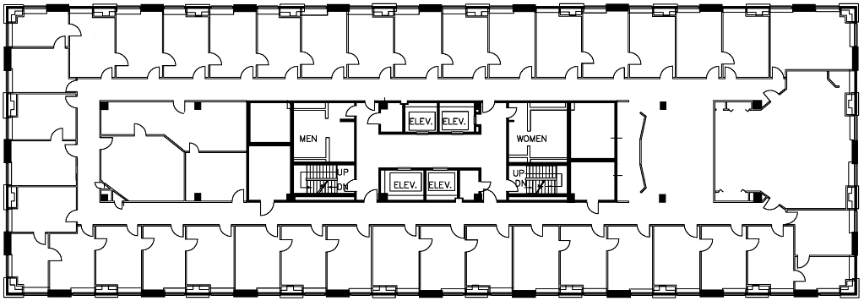
Indoor wireless network TESTBED
29 devices with 802.11b radios (fixed transmit power) in ‘ad hoc’ mode
2nd floor
3rd floor
5th floor
4th floor
6th floor
Notes:
We wanted to experiment with routing protocols, so we built an indoor testbed. The indoor testbed has many practical advantages for experimentation: ease of administration, upgrading, accessibility --- every node has a wired link for control. The rest of this talk will talk about results from the indoor network.
The indoor net is like a Roofnet, but inside: commodity PCs & 802.11 hardware, omnidirectional antennas. Although not identical, results on the indoor network should be indicative of the Roofnet.
Looking at all the previous work on ad hoc protocols, it seemed as if it should be easy to get any of those protocols to work on a small static network. We started by implementing DSDV.

Slide 7
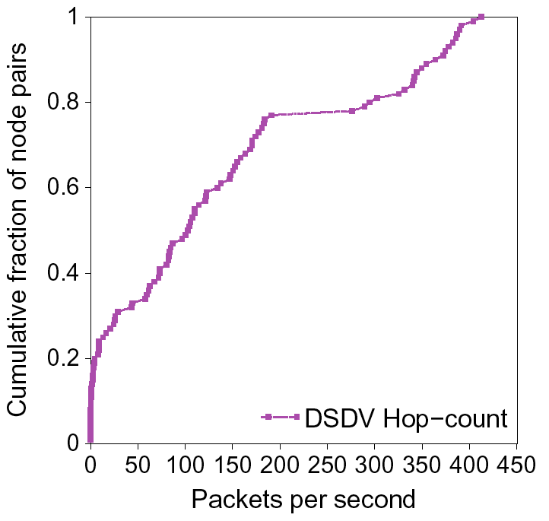
Testbed UDP throughput WITH HOP-COUNT
better
Better
Notes:
Unfortunately, the result was disappointing. We had poor latency for remote logins over the wireless network, and file transfers were slow. Since at one point we used the wireless network for control as well as experimentation, network performance problems were clear.
To be more precise about the problems, we ran UDP throughput tests. This figure shows CDF of UDP throughputs between 100 pairs of nodes using DSDV with min hopcount.
X-axis is pkts/sec; Y-axis is fraction of pairs that got less than that many pkts/sec
Example: 50% of pairs sent less than 100 pkts/sec
Lower right is better.
Max 802.11 throughput at this bit-rate and packet size is 451 pkts/sec, so some pairs are doing pretty well.
But 20% of pairs had ~0 throughput!
Clearly, those zeros are not great; but what would the right result look like? Is the network disconnected, for example?

Slide 8
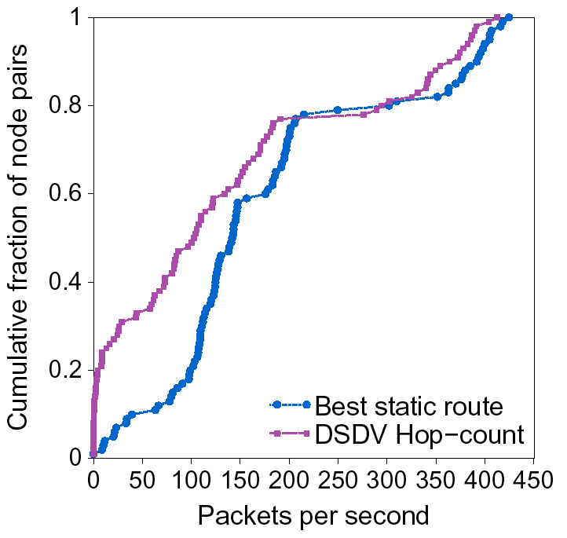
What throughput is possible?
Routing protocol
‘Best’ for each pair is highest measured throughput of 10 promising static routes
‘Best’
Notes:
Yes, we can do better. Best beats DSDV hop-count by a large margin. So we know DSDV is not doing as well as possible. Things to notice:
Notice 1-hop/2-hop distinction at horizontal segment -- when routing multi-hop, there is some throughput reduction to be expected.
For one-hop routes, we get approximately as good as we deserve.
Difference in one-hop routes is due to DSDV protocol overhead: route broadcasts.
DSDV finds many zero-throughput routes between many pairs, even though non-zero routes exist between those pairs.
For the rest of the multi-hop routes, DSDV still finds routes with much lower throughput than is possible -- by up to a factor of 2 to 5!

Slide 9
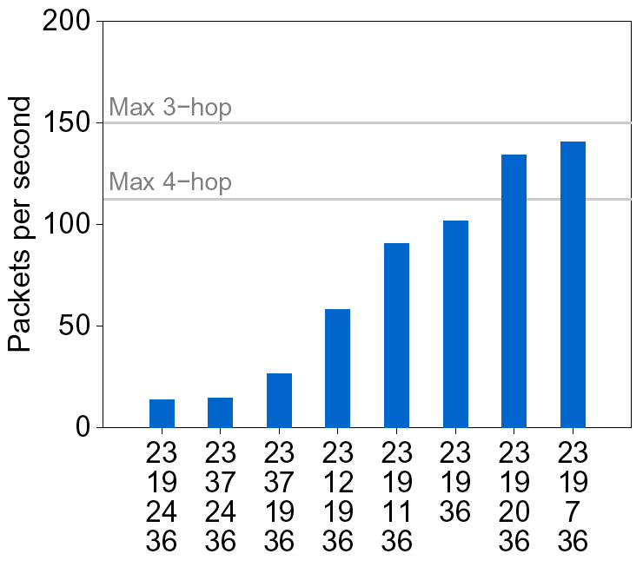
Throughput differs between paths
Paths from 23 to 36
Notes:
Because there is such variation in the links, there is also lots of variation in paths that can be found, even for the same hop count. This is why hop-count doesn’t do as well as the best.
more hops = larger number of potential paths, more variations
Minimum hop-count chooses essentially randomly between paths, so expected hop-count throughput is much less than the best found.

Slide 10
Challenge: more hops, less throughput
Links in network share radio spectrum
Extra hops reduce throughput
Throughput = 1
Throughput = 1/2
Throughput = 1/3
Notes:
Challenge number one: on shared-channel wireless networks, successive hops of a multi-hop route will interfere with each other.
Max 2-hop throughput = 1/2 -- Middle node has to send and receive each packet once.
Max 3-hop = 1/3 -- 1st and 3rd node can’t transmit at the same time, collisions at node 2.
Effect reaches steady state after about 4 or five hops, but exact behavior depends on the interference between nodes (radio parameters, propagation conditions, etc.)

Slide 11
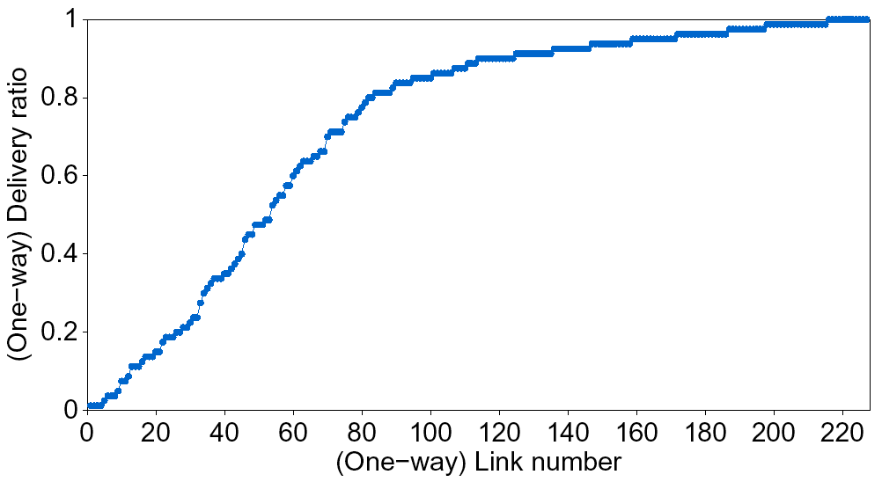
Challenge: many links are lossy
One-hop broadcast delivery ratios
‘Good’
‘Bad’
Smooth link distribution complicates link classification.
Notes:
Figure shows 227 non-zero (one-way) links out of 812 total.
Half of the (one-way) links deliver less than 90% of packets.
One-quarter of the links deliver less than 50% of packets.
So our routing protocol will probably find routes with a significant proportion of lossy links; it needs to be able to compare links and choose between good and bad links.
We can’t assume a bi-modal distribution and classify links as ‘good’ or ‘bad’, because wherever you place that threshold, a large number of potential links will be left on the wrong side of the threshold.
More importantly, though, sometimes the protocol will only be able to make a choice among all ‘bad’ links, or there may be many ‘good’ links -- as the distribution shows, there would still be lots of difference between links in the same category, which the protocol should take into account when choosing links. For example, choosing between a 60% link and a 40% link.
Other interesting note: hop-count will seek out marginal links: min hop-count == max distance per link.

Slide 12
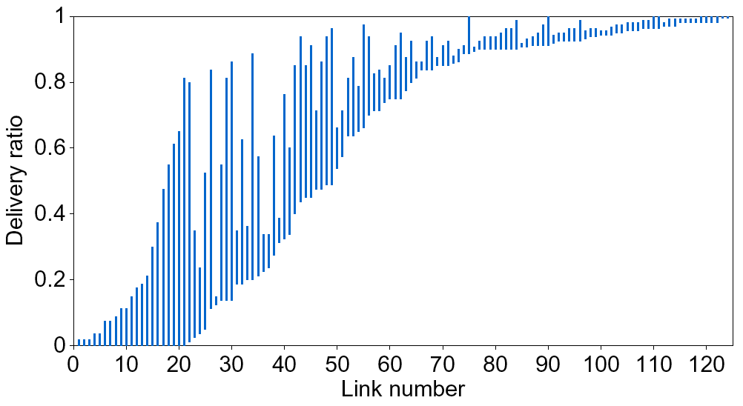
Challenge: many links are asymmetric
Broadcast delivery ratios in both link directions.
Very asymmetric link.
Many links are good in one direction, but lossy in the other
Notes:
Graph shows broadcast delivery ratios in each direction for all non-zero links. Things to notice are:
Not only are many links lossy, many are asymmetric. Many of the good links are the good side of an asymmetric link.
Asymmetric links have long bars, they have very different delivery ratios in the two directions.
Asymmetric links complicate routing protocols.

Slide 13
Effect of asymmetry on DISTANCE-VECTOR ROUTING
100%
A
B
8%
100%
100%
100%
100%
C
B successfully receives all of A’s route ads, and installs a one-hop route to A.
But, throughput of B-A = 0.08
B-C-A = 0.5
Notes:
Asymmetry can hurt the performance of a distance-vector type protocol -- route advertisement will always be heard over the link from A to B, causing B to install routes to A using that link. However, Node B’s throughput to A will only be about 10% of the maximum link throughput -- it would be better to use a 2-hop route via C with 50% throughput.
Transition to next slide: so we’ve got these 3 problems (longer routes have less throughput; many links are lossy; many links are asymmetric). How can we use a route metric to find high-throughput paths in the face of these problems.

Slide 14
A strawman route metric
Maximize bottleneck throughput
B
Delivery ratio = 100%
50%
A
C
51%
51%
D
Bottleneck throughput:
A-B-C = 50%
A-D-C = 51%
A-B-C : ABBABBABB = 33%
A-D-C : AADDAADD = 25%
Actual throughput:
Notes:
Here is one metric that aims to find high throughput routes.
Unfortunately it doesn’t work for our case with shared channels and link-layer retransmissions.
Notice what happens in the actual throughput examples. On average, every other tx by A, B, or D gets lost (red splats), but they still occupy space & time, using up potential throughput.

Slide 15
Another strawman metric
Maximize end-to-end delivery ratio
B
100%
51%
A
C
50%
A-B-C = 51%
A-C = 50%
End-to-end delivery ratio:
A-B-C : ABBABBABB = 33%
A-C : AAAAAAAA = 50%
Actual throughput:
Notes:
Neither of these two metrics select the route with the highest throughput. In fact, on our sorts of network, they will make very bad choices. And what we are interested in is finding the highest throughput path.
To be fair, max bottleneck throughput would likely work well with point-to-point links, and max e2e delivery ratio would likely work well in the absence of link-layer retransmissions.

Slide 16
New metric: ETX
Minimize total transmissions per packet
(ETX, ‘Expected Transmission Count’)
Link throughput ≈ 1/ Link ETX
Delivery Ratio
Link ETX
Throughput
100%
1
100%
50%
2
50%
33%
3
33%

Slide 17
Calculating link ETX
Assuming link-layer acknowledgments (ACKs) and retransmissions (true in 802.11, BLE, 802.15.4, etc.):
P(TX success) = P(Data success) × P(ACK success)
Link ETX = 1 / P(TX success)
= 1 / [ P(Data success) × P(ACK success) ]
Estimating link ETX:
P(Data success) ≈ measured fwd delivery ratio r_{fwd}
P(ACK success) ≈ measured rev delivery ratio r_{rev}
Link ETX ≈ 1 / (r_{fwd} × r_{rev})

Slide 18
Measuring delivery ratios
Each node broadcasts small link probes (with Wi-Fi, this paper uses 134 bytes), once per second
Nodes remember probes received over past 10 seconds
Reverse delivery ratios estimated as
r_{rev} ≈ pkts received / pkts sent
Forward delivery ratios obtained from neighbors (piggybacked on probes)
There are other ways to obtain this information

Slide 19
PATH (“ROUTE”) ETX
Path ETX = Sum of link ETXs
Route ETX
Throughput
1
100%
2
50%
2
50%
3
33%
5
20%

Slide 20
ETX Properties
ETX predicts throughput for short routes (1, 2, and 3 hops) for wireless networks with link-layer retransmissions and a shared medium
ETX quantifies loss
ETX quantifies asymmetry
ETX quantifies throughput reduction of longer routes
Notes:
Although the ETX implementation may make errors in throughput prediction, we don’t actually care about exactly predicting throughput: we want to rank routes in order of throughput. So systematic mistakes (under/over-predictions) aren’t a problem.
ETX is designed especially for link-layer ACKs; it doesn’t make any sense otherwise.

Slide 21
ETX caveats
ETX link probes are susceptible to MAC unfairness and hidden terminals
Route ETX measurements change under load
ETX estimates are based on measurements of a single link probe size (e.g., 134 bytes)
Under-estimates data loss ratios, over-estimates ACK loss ratios
But there are ways around this problem
ETX assumes all links run at one bit-rate
Subsequent work has been done to overcome this problem, leading to “ETT”, the expected transmission time metric

Slide 22
Evaluation Setup
Indoor network, 802.11b, ‘ad hoc’ mode
1 Mbps, 1 mW, small packets (134 bytes), RTS/CTS disabled
DSDV + modifications to respect metrics
Packets are routed using route table snapshot to avoid route instability under load.
Also: DSR + modifications to respect metrics
(DSDV and DSR are two different routing protocols for mesh networks)
Notes:
Using 1mW instead of 30mW makes the network less connected, giving longer routes and fewer very good links. However, the number of marginal links is about the same.
1 mW provides *fewer* route choices [although more practical choices, because there are fewere pairs with one-hop routes, which means more pairs are actually choosing between multi-hop routes].
DSDV is a proactive distance vector protocol; DSR is a reactive source routing protocol.

Slide 23
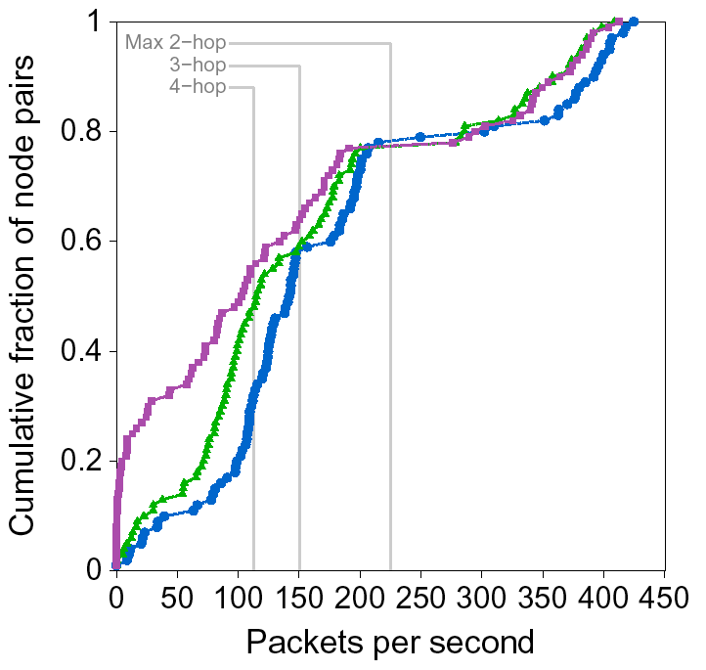
ETX improves DSDV throughput
DSDV overhead
DSDV+hop-count
better
DSDV+ETX
‘Best’
Notes:
Why does DSDV+ETX do better than DSDV+hop-count?
ETX avoids all of the asymmetric links (bottom left of purple line)
But even where hop-count was finding routes that work, ETX is finding better routes, because it is avoiding lossy links in general, e.g. in the middle-left of the graph.
ETX can only increase throughput for pairs that do not have 1-hop routes. Since both hop-count & ETX find the same 1-hop routes, the throughput is the same -- that’s the right side of the graph where all the lines are the same.
We notice that neither ETX nor hop-count do as well as ‘best’ for the 1-hop routes on the right -- that’s because of the DSDV overhead.
ETX provides the most benefit for pairs that are many hops away -- the more hops, the better is ETX’s advantage, because more hops means more possible routes; more possible routes means hopcount is more likely to choose a bad route.
There are still one or two zeros; these are nodes that didn’t have any good links during the experiment.
[ don’t refer to right or left -- use ‘upper right’, and ‘lower left’ ]
[ discuss ‘zeroes’ or not? ]
Avg. ETX throughput: 158 pkts/sec
Avg. hop-count throughput: 137 pkts/sec
15% improvement
Ignoring 1-hops:
ETX: 101
Hop-count: 73
38% improvement

Slide 24
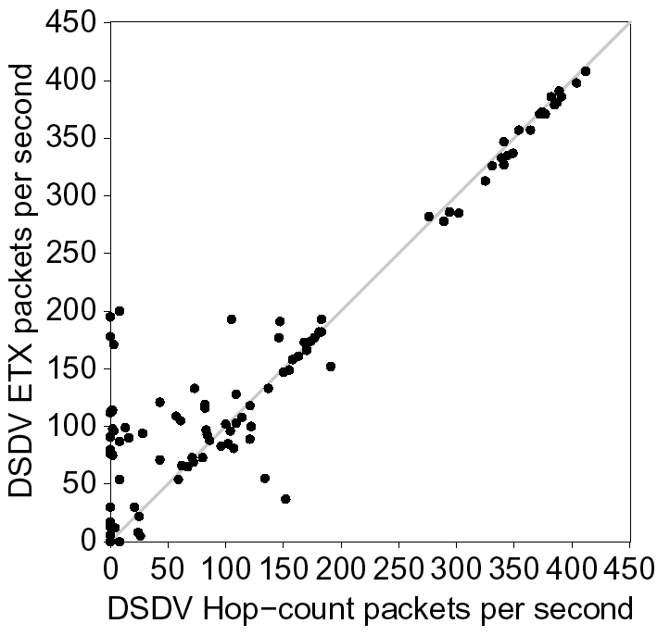
Per-pair DSDV throughputs

Slide 25
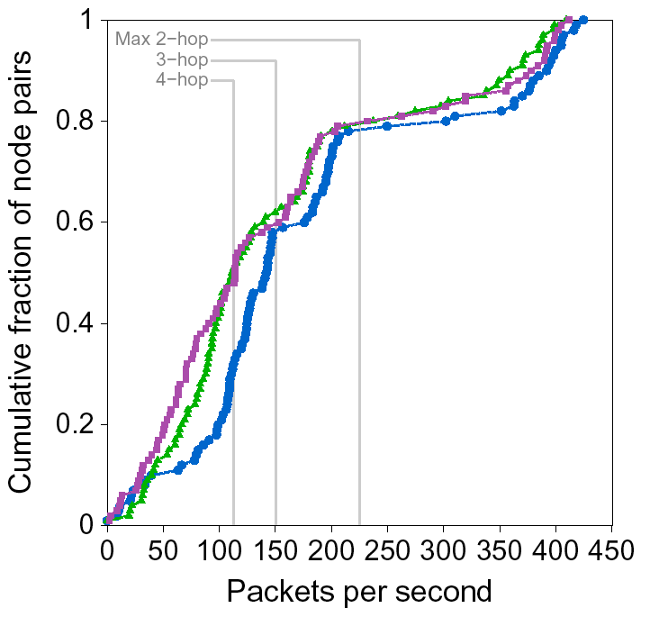
DSR with ETX
DSR+hop-count
DSR+ETX
‘Best’
Notes:
TX feedback allows DSR to switch up to a better route when a link loses packets, so even if DSR finds routes with lossy links, it can switch to a better route when packet losses occur. In this way, DSR is always improving the route quality.
However, ETX provides some benefit: it lets DSR start of with better routes, avoiding the time DSR wastes using bad routes before switching to good routes -- although we don’t know if that is the reason for the gap on this slide, or not.
Because our DSR implementation has a link cache, DSR can find and switch to a new route without even performing a route request broadcast -- it simply re-runs Dijkstra’s algorithm over the non-broken links it knows about. So new route requests are very rare. Although I can’t quantify it, so don’t talk about it.

Slide 26
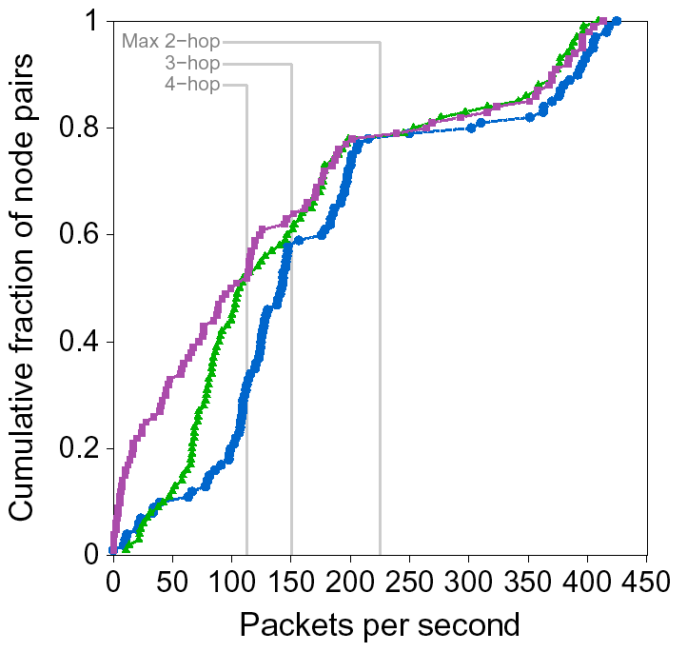
DSR with ETX (no TX feedback)
DSR+hop-count
DSR+ETX
‘Best’
Notes:
Without TX feedback, DSR uses the first shortest route it finds. Adding ETX enables DSR to better select an initial route. TX feedback and route metrics can be seen as orthogonal mechanisms.
RTM says don’t talk about this, because tx feedback seemed to work pretty well in our experiments [ when would this be the case ]: For example, you might not want to switch off of a route just because of a few seconds of transmission failure -- it may still be the fastest route out there, on average.

Slide 27
Some related work
Threshold-based techniques
DARPA PRNet, 1970s–80s [Jubin87]: Minimum hop-count, ignore ‘bad’ links (delivery ratio < 5/8 in either direction)
Link handshaking [Lundgren02, Chin02]: Nodes exchange neighbor sets to filter out asymmetric links.
SNR-based approaches [Hu02]: Mark low-SNR links as ‘bad’, and avoid them
Mote sensors
Product of link delivery ratios [Yarvis02]
Woo and Culler: Similar proposal to ETX for sensor networks (~concurrent)
Notes:
Many other people have noticed the problems with poor wireless links, and many different ideas have been proposed and implemented.

Slide 28
Summary
ETX is a new route metric for multi-hop wireless networks
ETX accounts for
Throughput reduction of extra hops
Lossy and asymmetric links
Link-layer acknowledgements
ETX finds better routes!
Notes:
[ ETX will be more important for bigger networks? -- finding good routes will be more important; is ETX the best way to find good routes? It doesn’t suck, anyway… ]

Slide 29
Even longer range (city-scale)
Device’s data rate (“duty cycle”)
Gbytes per day
bytes per day
20 years
hours
inches
Battery life (low-power operation)
body/room
building
factory/ campus
miles
Device-to-gateway range

Slide 30
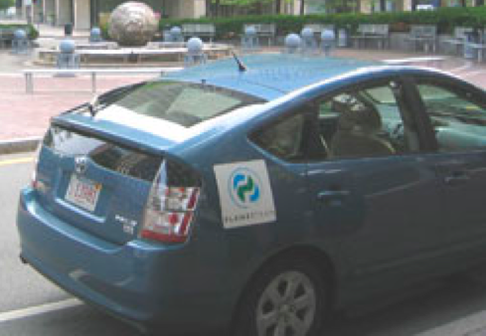
When the internet is miles away
Use mobile devices
as data mules
Trade-off: delay
Delay-tolerant network (DTN)
Example we will study: Zebranet

Slide 31
What if we want long range and low delay?
“Long-range IoT networks”
Examples: Sigfox, LoRaWAN, cellular IoT proposals (narrowband LTE, etc.)
Low-power designs (months to years of battery life)
Low or ultra-low throughput (a few bytes per day to achieve long-enough battery life at a rate of a few kbps)
Networks like LoRaWAN also include localization capabilities

Slide 32
What if we want long range and low delay
Second choice: Cellular (of course!)
Examples: LTE/4G, 3G, etc.
High-power consumption, so only when power isn’t an issue
Delay still a concern for data-intensive, latency-sensitive applications

Slide 33
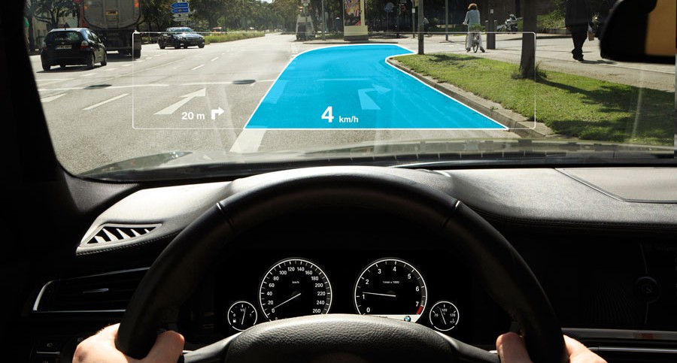
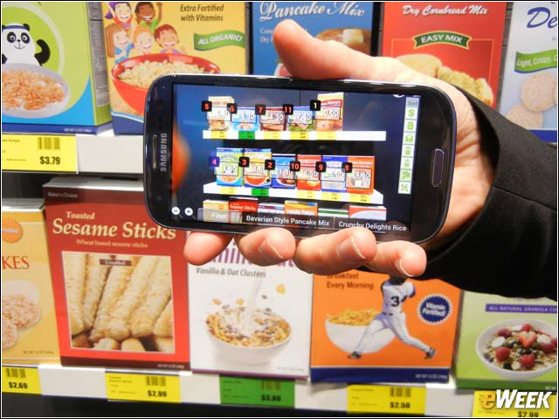

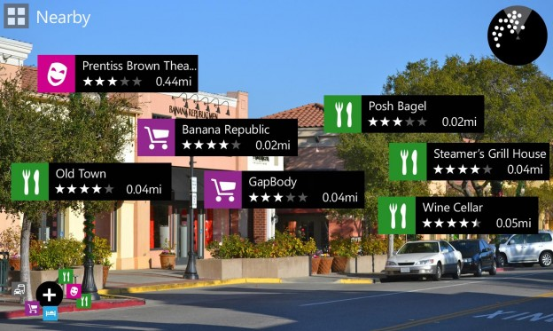
Continuous recognition apps
SLOW
Driver Assistance
Augmented Reality Shopping
Face Recognition
Augmented Reality Tourist App

Slide 34




Glimpse: continuous real-time recognition
Continuous, real-time object recognition on mobile devices in a video stream
Continuously identify and locate objects in each frame
Alice
Alice
Bob
Alice
Bob
Alice
Bob
T. Chen, L. Ravindranath, S. Deng, P. Bahl, H. Balakrishnan, SenSys 2015
We will study this paper later in the course

Slide 35

Recognition pipeline
Detection
Feature Extraction
Classification
Stop Sign
T. Chen, L. Ravindranath, S. Deng, P. Bahl, H. Balakrishnan, SenSys 2015

Slide 36
Recognition pipeline
Detection
Feature Extraction
Classification
Stop Sign
Computationally expensive and memory-intensive
Server is hundreds of times faster than embedded/mobile computer
Scaling to large number of images requires servers

Slide 37
Solution: server offload
Server
Detection
Feature Extraction
Classification
Frame
Network
Labels,
bounding boxes
Client
Camera
Display
Two big challenges
End-to-end latency lowers object recognition accuracy
2. Bandwidth and battery-efficiency

Slide 38





IDEA: Device-side active cache
Cache and run tracking through the cached frames
Server
Network
Active Cache
Frame 0

Slide 39

Server
Alice
Network
Active Cache
Frame 0

Slide 40
Server
Network
Active Cache
Alice
Run tracking from Frame 0 to Frame 30
Frame 0
Frame 30

Slide 41
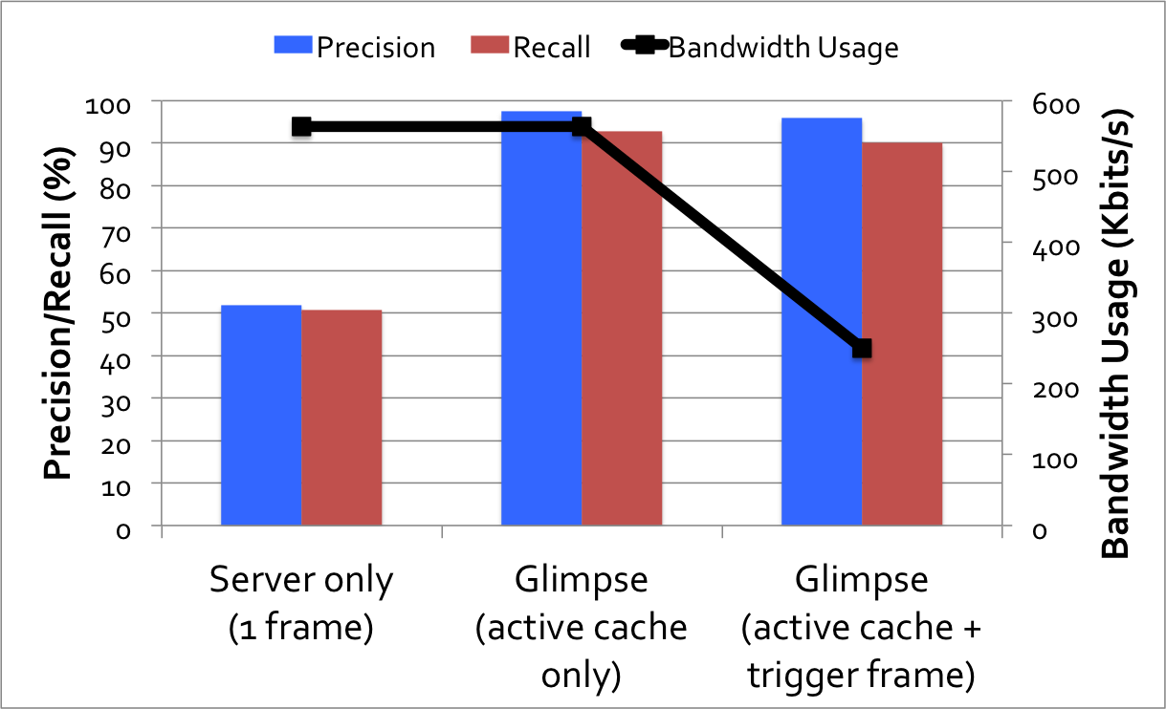
Performance on faces
Average end-to-end frame delay to server and back: 430 ms

Slide 42
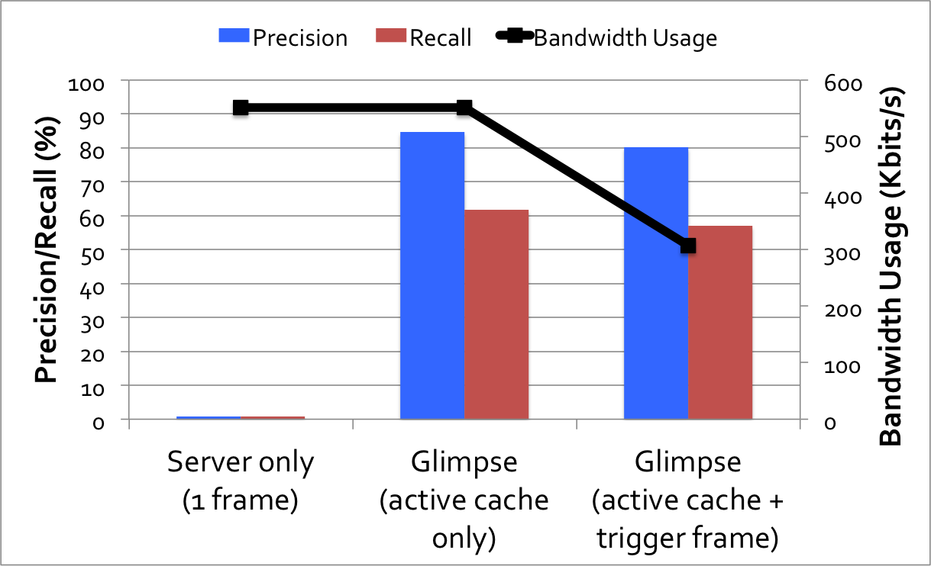
Performance on road signs
Average end-to-end frame delay to server and back: 520 ms

Slide 43
SUMMARY AND PLAN
Rich design space for things-gateway communication
Think along three dimensions:
data rate/duty cycle
battery
range
Case studies
Low-power design (Bluetooth LE): advertisement, time-scheduled MAC
Range extension techniques
Mesh networking
Muling
In-network computing and aggregation (LEACH, TAG)
Data-intensive IoT: continuous recognition
Servers
Internet
Gateways
Device’s data rate (“duty cycle”)
10s of Mbits/s
bytes per day
hours
20 years
Things
inches
body/room
Battery life (low-power operation)
building
factory/campus
miles
Device-to-gateway range

Slide 44
Open questions and future work
What if you want city-scale, high-rate, low-power sensing? (e.g., high-fidelity vibration, weather, image sensors)
Current systems gated by standby power (microWatts)
Recent advances have shown nanoWatt standby power
How will this change IoT networks?
Current IoT apps are “siloed” from each other How to integrate them?

Slide 45
DE-Siloing
Today: build IoT devices/sensors, build an app, build a cloud service
Vertically-integrated: hard to integrate and slows innovation Gateway functions are repeatedly invented
The issue: real value is in the data, not in the devices!
Possible (non-exclusive) approaches
Coordinate access to data via server-side APIs in the cloud
Provide access to data in smartphone apps via “kits” (HomeKit, Healthkit, Google Fit, …)
Develop a generic gateway (multiple technologies)

Slide 46
predictions
Shake-up in standards: multiple winners, but they will divide up the “three-dimensional space”
Ultra-low power IoT systems and networks
Compute-intensive (data-intensive) IoT systems and networks
De-siloed architectures
Smartphone-centric v. hidden (ubiquitous) computing
Notes:
Anticipate changes and innovations in the coming years

